Slide 1

BIG DATA ANALYTICS
BDA
TOPIC:CONSTRAINT BASED CLUSTERING

Slide 2
Practical Google Colab Links :
1) https://colab.research.google.com/drive/141M7oOFBBi7LSqBZlj_8VoG_N-RWY2QV?usp=sharing 2) https://colab.research.google.com/drive/1mmsHpdfq1LBx14MkxUNMlZEg0NOWRlED?usp=sharing
3) https://colab.research.google.com/drive/1cOMITNa6XoXxYqa9HnA1OWWrQcBcbOcO?usp=sharing

Slide 3
Agenda :
- What is Clustering ?
- What is Constraint – Based Clustering ?
- Classification Of Constraint – Based Clustering.

Slide 4
What is Clustering ?
Clustering is a type of unsupervised learning method of machine learning.
Clustering is a task of dividing the data sets into a certain number of clusters (Groups) in such a manner that the data points belonging to a cluster have similar characteristics.
Clusters are the regions where the density of similar data points is high.
Msc IT Part I Sem II BDA - Constaint Based clustering. Sneha Pawar - 11

Slide 5
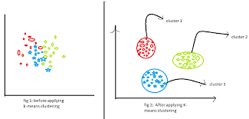

Slide 6
What is Constraint – Based Clustering ?
Constraint :- Limitation or Restriction.
Constraint – Based Clustering is a Semisupervised approach to clustering & Based on “WEAK” Supervision.
The constraints are usually expressed as pairwise statements indicating that two items must, or cannot, be placed into the same cluster.
Constrained clustering algorithms may enforce every constraint in the solution, or they may use the constraints as guidance rather than hard requirements.
Msc IT Part I Sem II BDA - Constaint Based clustering. Sneha Pawar - 11

Slide 7
The Constraint refers to the user expectation or the properties of desired clustering result.
The constraint give us the interactive way of communication with the clustering process.
The constraints can be specified by the user or the application requirement.
Msc IT Part I Sem II BDA - Constaint Based clustering. Sneha Pawar - 11

Slide 8
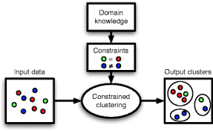

Slide 9
Few Categories of Constraints :
Constraints on Indivisual Objects
Constraints on the selection of clustering parameters
Constraints on distance or similarity functions
User-Specified constraints on the properties of individual clusters
Semi-Supervised clustering based on “Partial” supervision.

Slide 10
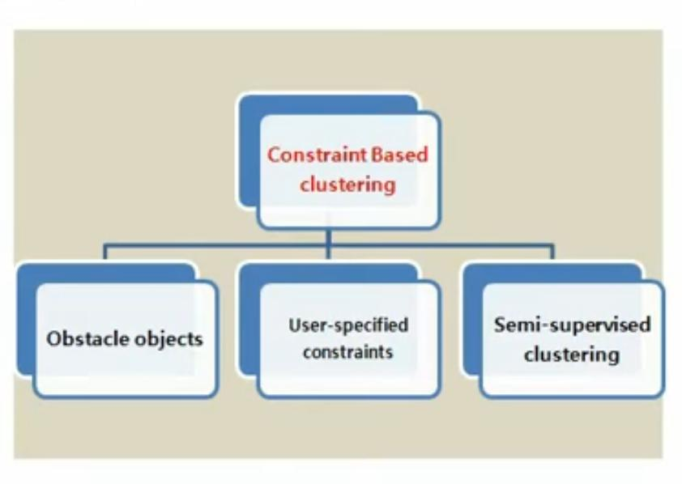
Classification Of Constraint – Based Clustering :

Slide 11
Clustering With Obstacle Objects :
City – rivers, lakes, bridges, roads etc.
Obstacles must be avoided
Distance function between objects must be re – defined (Straight line distance is meaningless).
When using a partitioning approach – distance calculation with obstacles becomes expensive.
- K – Means : not suitable as cluster center may lie on an obstacle.
- K – Medoid can be used & distance between objects can be determined using triangulation.
To reduce cost of distance computation points can be grouped into micro clusters & process the micro – clusters instead of points.

Slide 12
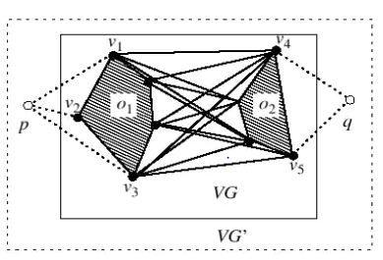
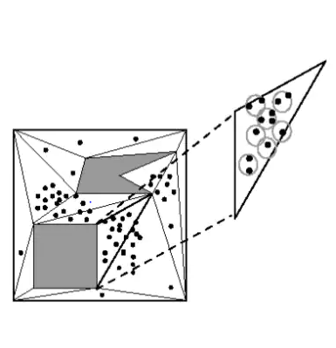
Msc IT Part I Sem II BDA - Constaint Based clustering. Sneha Pawar - 11

Slide 13
User – Constrained cluster Analysis :
Example : Relocating package delivery centers.
N Customers : High value and ordinary customers.
Determine locations for K service stations
Constraints :
Each station should server
At least 100 High Value Customers.
At least 5000 Ordinary Customers.
Direct mathematical approach will expensive. So, we can use the Micro Clustering technique.
(To increase the clustering efficiency, data can first be preprocessed using the micro clustering idea to form micro clusters [groups of points that are close together] thereby avoiding the processing all the points individually.)
Msc IT Part I Sem II BDA - Constaint Based clustering. Sneha Pawar - 11

Slide 14
Semi – Supervised Cluster Analysis:
Constraint based Semi – Supervised Clustering :
- Relies on user provided labels or constraints.
- Initialize based on labeled objects.
- Modify objective function.
Distance based Semi – Supervised Clustering :
- Adaptive distance measure trained to satisfy labels or constraints.
Msc IT Part I Sem II BDA - Constaint Based clustering. Sneha Pawar - 11

Slide 15
Thank You !
Msc IT Part I Sem II BDA - Constaint Based clustering. Sneha Pawar - 11

